Slide 1
Meeting with Oksana
27/03

Slide 2
Tasks From Last Meeting
Generate dataset with IsaacSIM
Install v2e
Generate plots of prediction in time

Slide 3
Completed Tasks

Slide 4
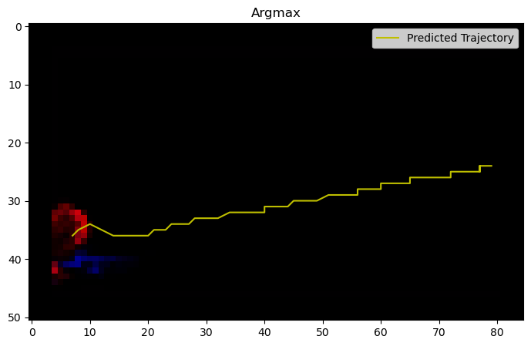

Argmax vs Weighted Average

Slide 5
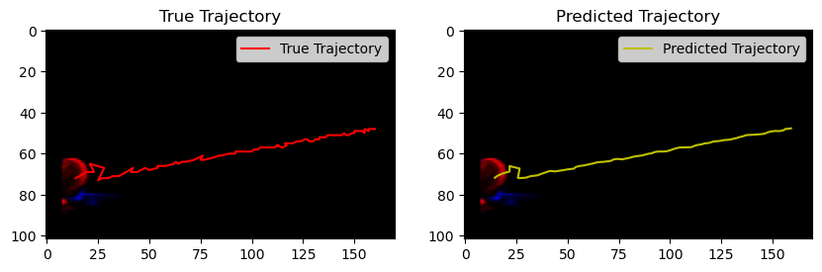
Video Plots q4

Slide 6
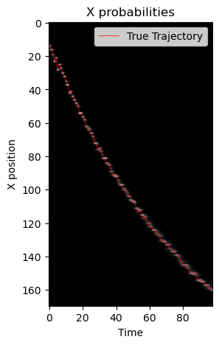
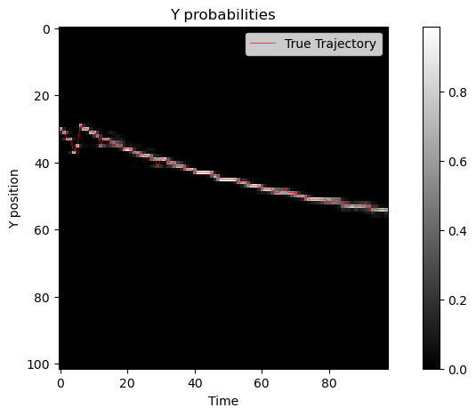
Video Plots q4

Slide 7
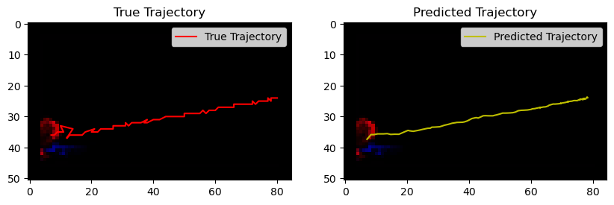
Video Plots q8

Slide 8
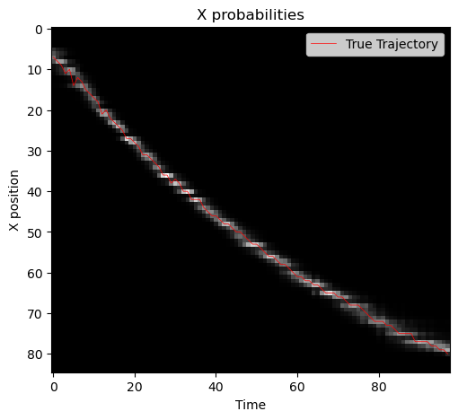
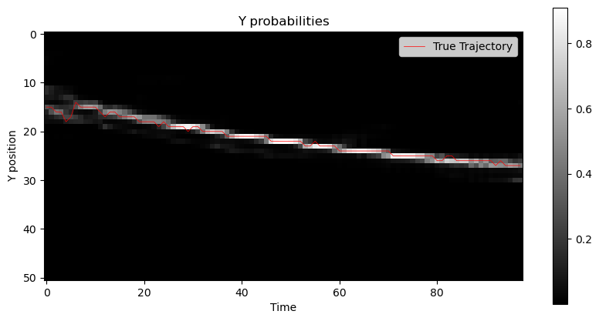
Video Plots q8

Slide 9
Ongoing and Proposed Future Tasks

Slide 10
Ongoing Tasks
Generating a dataset with IsaacSIM
Shadow is still present
Three options
Keep trying to get rid of it
Generate videos with the shadows
Wait 1s between screenshots -> 3s per screenshot
Problem: too much time (days) for generating a dataset.
1000 fps -> 3 hours per video (due to the shadow, maybe 1h if I can remove it)
Solution: frame interpolation (v2e)

Slide 11
Ongoing Tasks
V2E installation
I can’t install some of the modules

Slide 12
Proposed Future Tasks
Experiment with the weighted average in the models
Finish V2E installation
Generate the IsaacSim dataset 10ms with shadow

